Slide 1
SUAY Progress Update
MHRN Steering Committee Meeting
November 28, 2017
NIMH - Bethesda, MD

Slide 2
Phase 2 Major Goals
Conduct a pilot study at 2 sites;
Test acceptability and adherence by clinicians, patients, and their families;
Test validity, moderators and mediators;
Finalize the trial protocol;
Deliver a de-identified database and report

Slide 3
Description of Pilot Study
2 arm randomized trial at KP Washington and Nationwide Children’s Hospital.
Study intervention:
  Best practice alert for antipsychotic medications
  Case review by a child/adolescent psychiatrist
  Behavioral Health navigation/coordination (3 mo)
  Bridging therapy (up to 9 sessions)

Slide 4
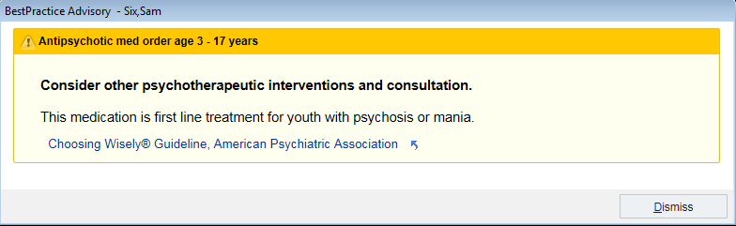

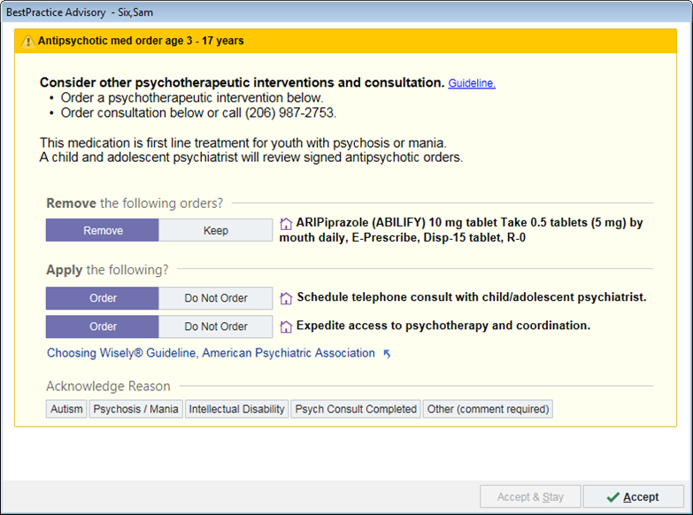
Mock best practice alerts

Slide 5
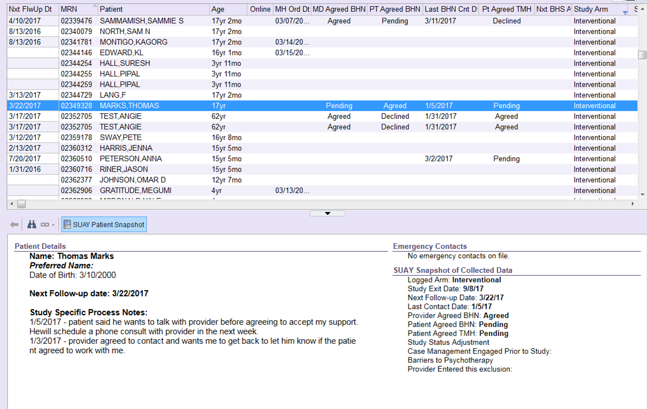
Mock BHN workbench

Slide 6
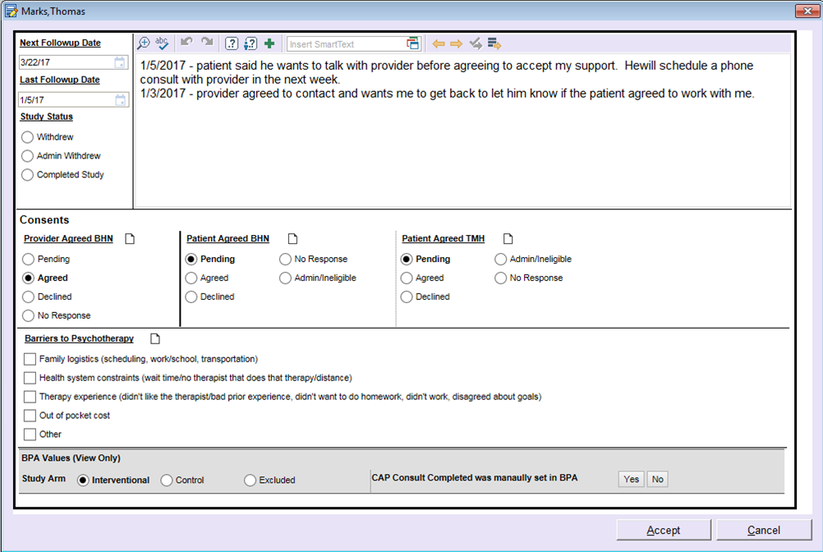
Mock BHN workbench

Slide 7
Pilot enrollment (4/25 through 7/18)
 | Control | Intervention | Total
Eligible providers | 9 | 9 | 18
Eligible patients | 6 | 20 | 26
TOTAL | 15 | 29 | 44

Slide 8
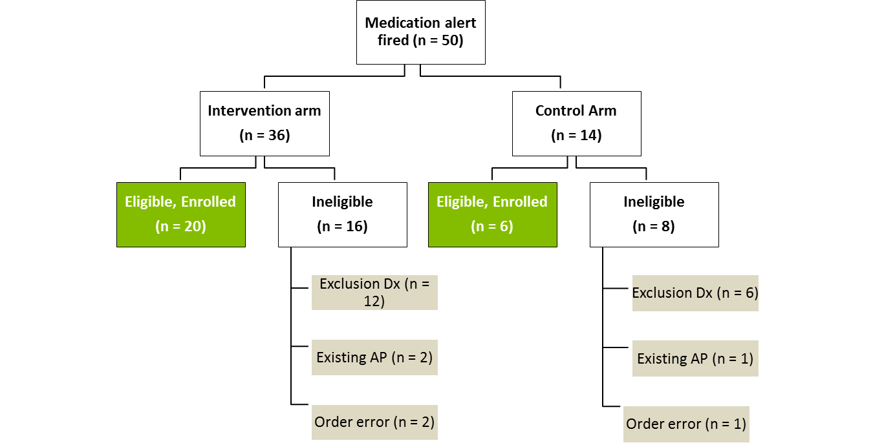
Pilot Study CONSORT Diagram

Slide 9
Subject Demographics
 | Eligible Subjects (n=26)
Age (years) | n | %
3-6 years | 1 | 4%
7-12 years | 6 | 23%
13-17 years | 19 | 73%
Gender | N | %
Male | 15 | 58%
Female | 11 | 42%
Race | N | %
Asian | 1 | 4%
Black or African American | 4 | 16%
White or Caucasian | 17 | 65%
More than One Race | 2 | 8%
Other | 2 | 8%
Ethnicity | N | %
Hispanic or Latino Origin | 1 | 4%
Not Hispanic or Latino | 22 | 84%
Unknown / Not Reported Ethnicity | 3 | 12%

Slide 10
Provider Acceptability
Providers said the alert did not alter their decision-making, yet was not burdensome;
Psychiatrists questioned the utility of an unsolicited second opinion;
Acceptability was better at NCH where a NCH supervising psychiatrist conducted the review;
BH navigation was widely valued by providers.

Slide 11
Patient Acceptability - Navigation
65% agreed to navigation, 25% declined, and 10% could not be reached;
Reasons for declining: doing OK, already in therapy, do not think it will benefit them;
1 youth actively declined navigation;
We received no complaints from patients or families about being contacted.

Slide 12
Patient Acceptability – Bridging Therapy
69% were NOT offered bridging therapy (e.g., already in therapy, not a good candidate, etc.);
Of those offered (n = 4): 50% declined in favor of other options (e.g., reconnect with past therapist, school-based counseling);
Adequate acceptability and adherence data from the pilot is not available to generalize to the main trial due to small numbers.

Slide 13
Additional Refinements for Phase 3 Trial
Blinded eligibility confirmation step;
Separate TMH and BHN order options in alert;
Patient-reported medication flag;
Dot-phrases to standardize structure of reviews;
Enhanced communication strategy re: trial;
Improvements to BHN workbench;
Revisions to TMH workflows (e.g., initial session, tech checks, privacy and safety assessments).

Slide 14
Recent accomplishments
Sept 19: Phase 3 Epic package provided to sites
Sept 21: Final BH navigation call for pilot study
Oct 3: Preliminary DSMB approval for trial
Oct 11: Draft final phase report delivered to NIH
Oct 18: KPWA IRB approval & waivers for trial
Oct 25: Preliminary funding notice for trial
Nov 1-2: HFHS implementation site visit
Nov 7: Pilot data transfer from NCH to KPWA

Slide 15
Upcoming milestones
Dec 4-5: KPCO implementation site visit
Dec 19: Final deliverables to NIH
  De-identified database
  Data dictionary
  Final phase report
Dec 19: Final pilot DSMB report
Dec 24: Option period 1 end date

